Slide 1

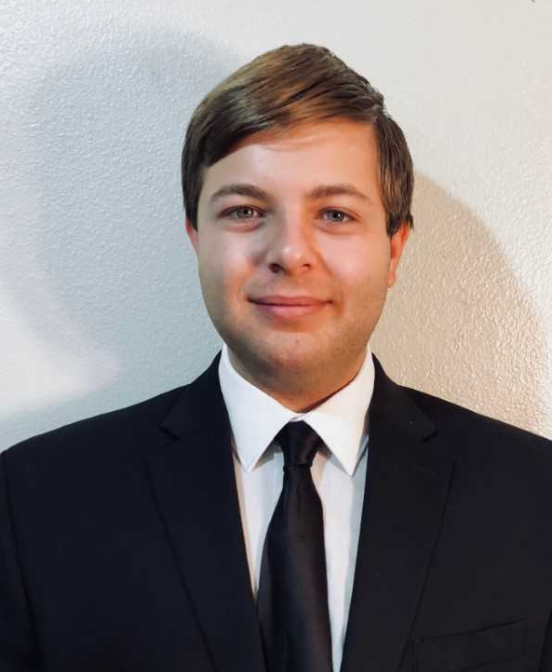
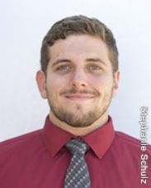
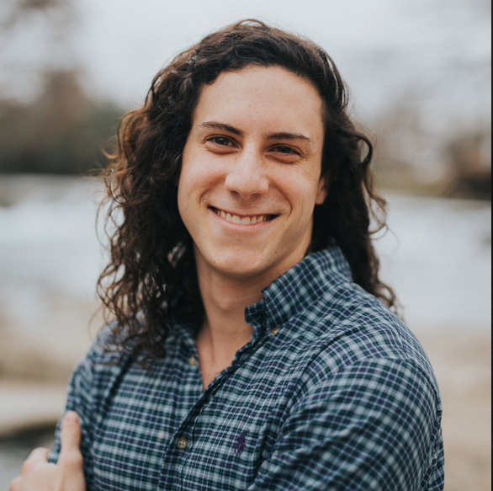
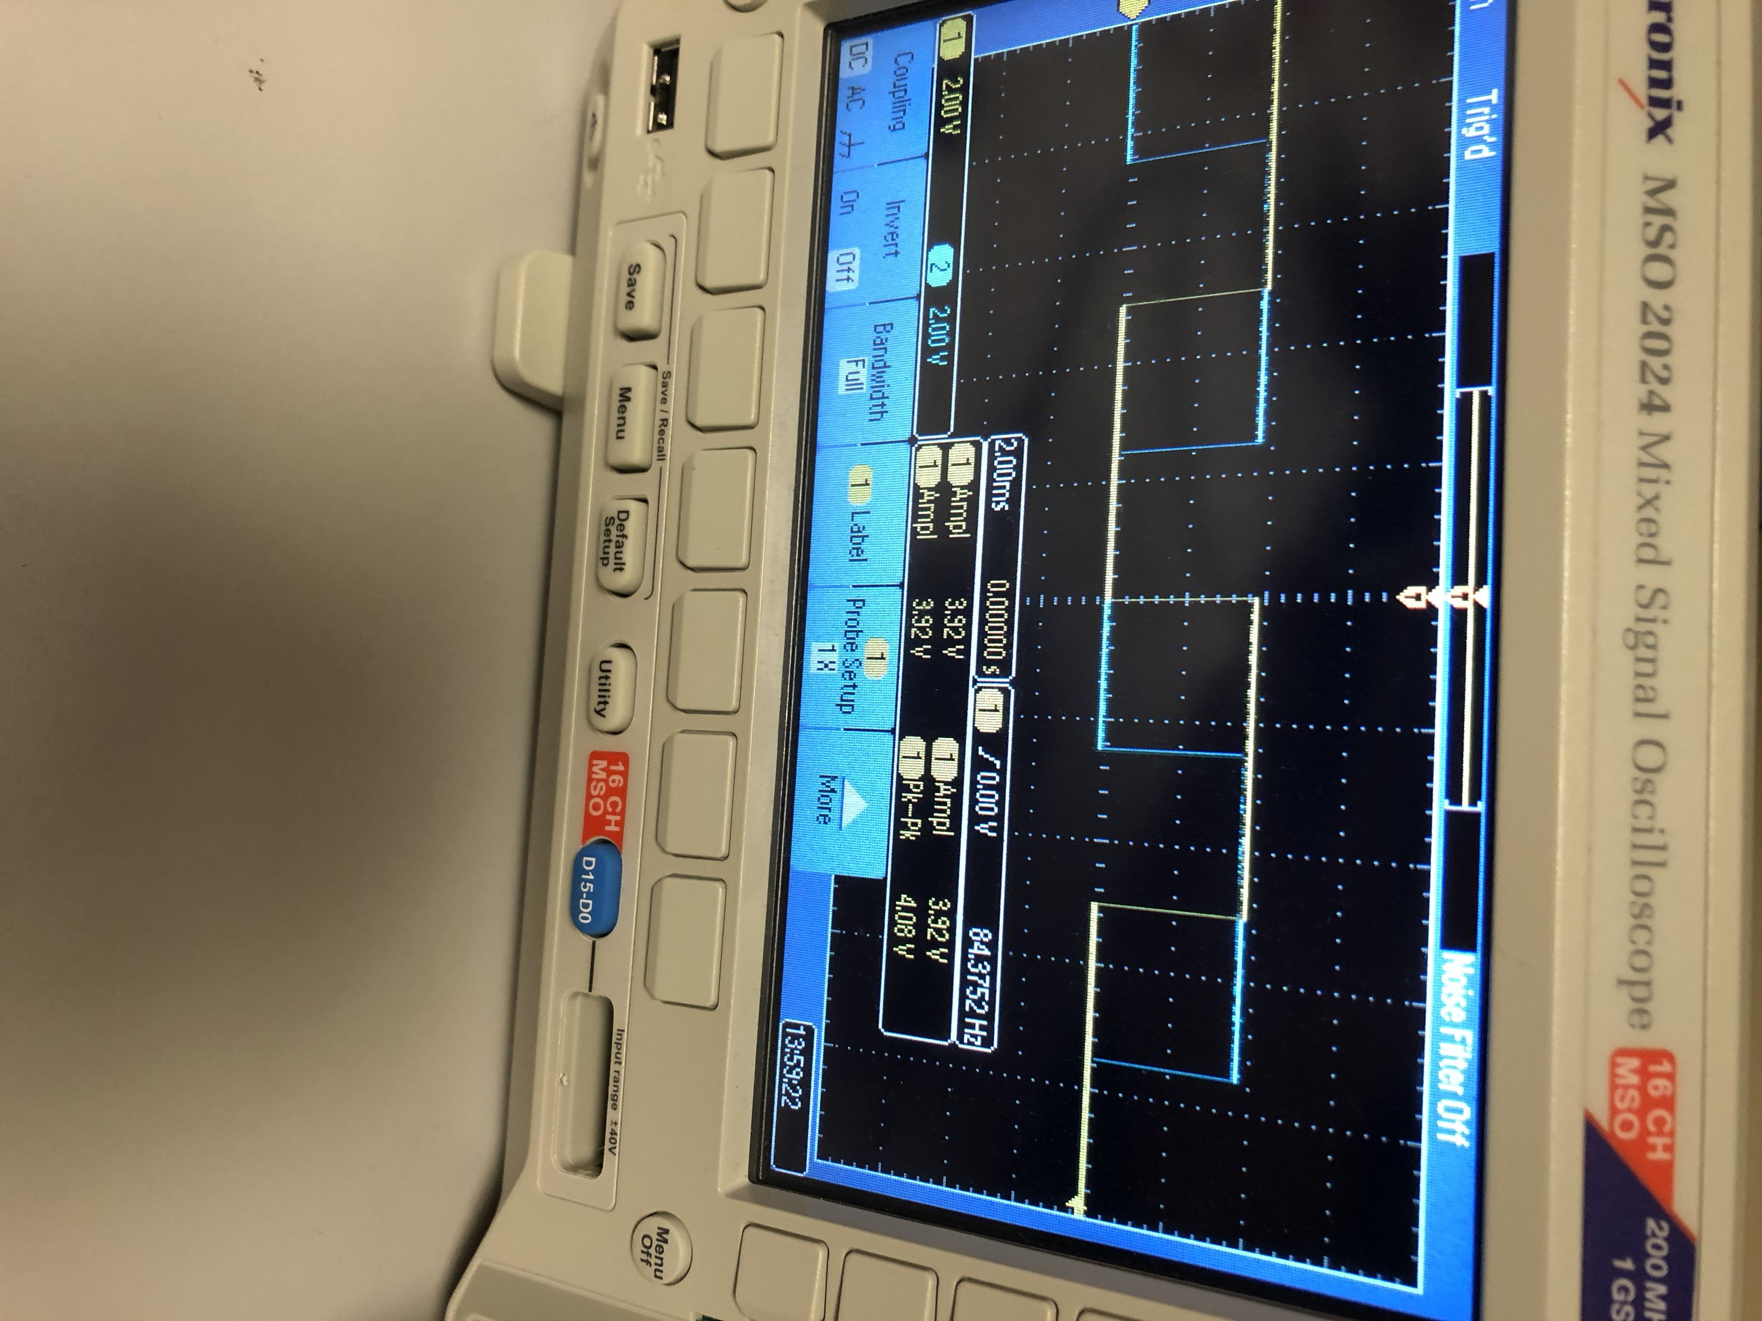
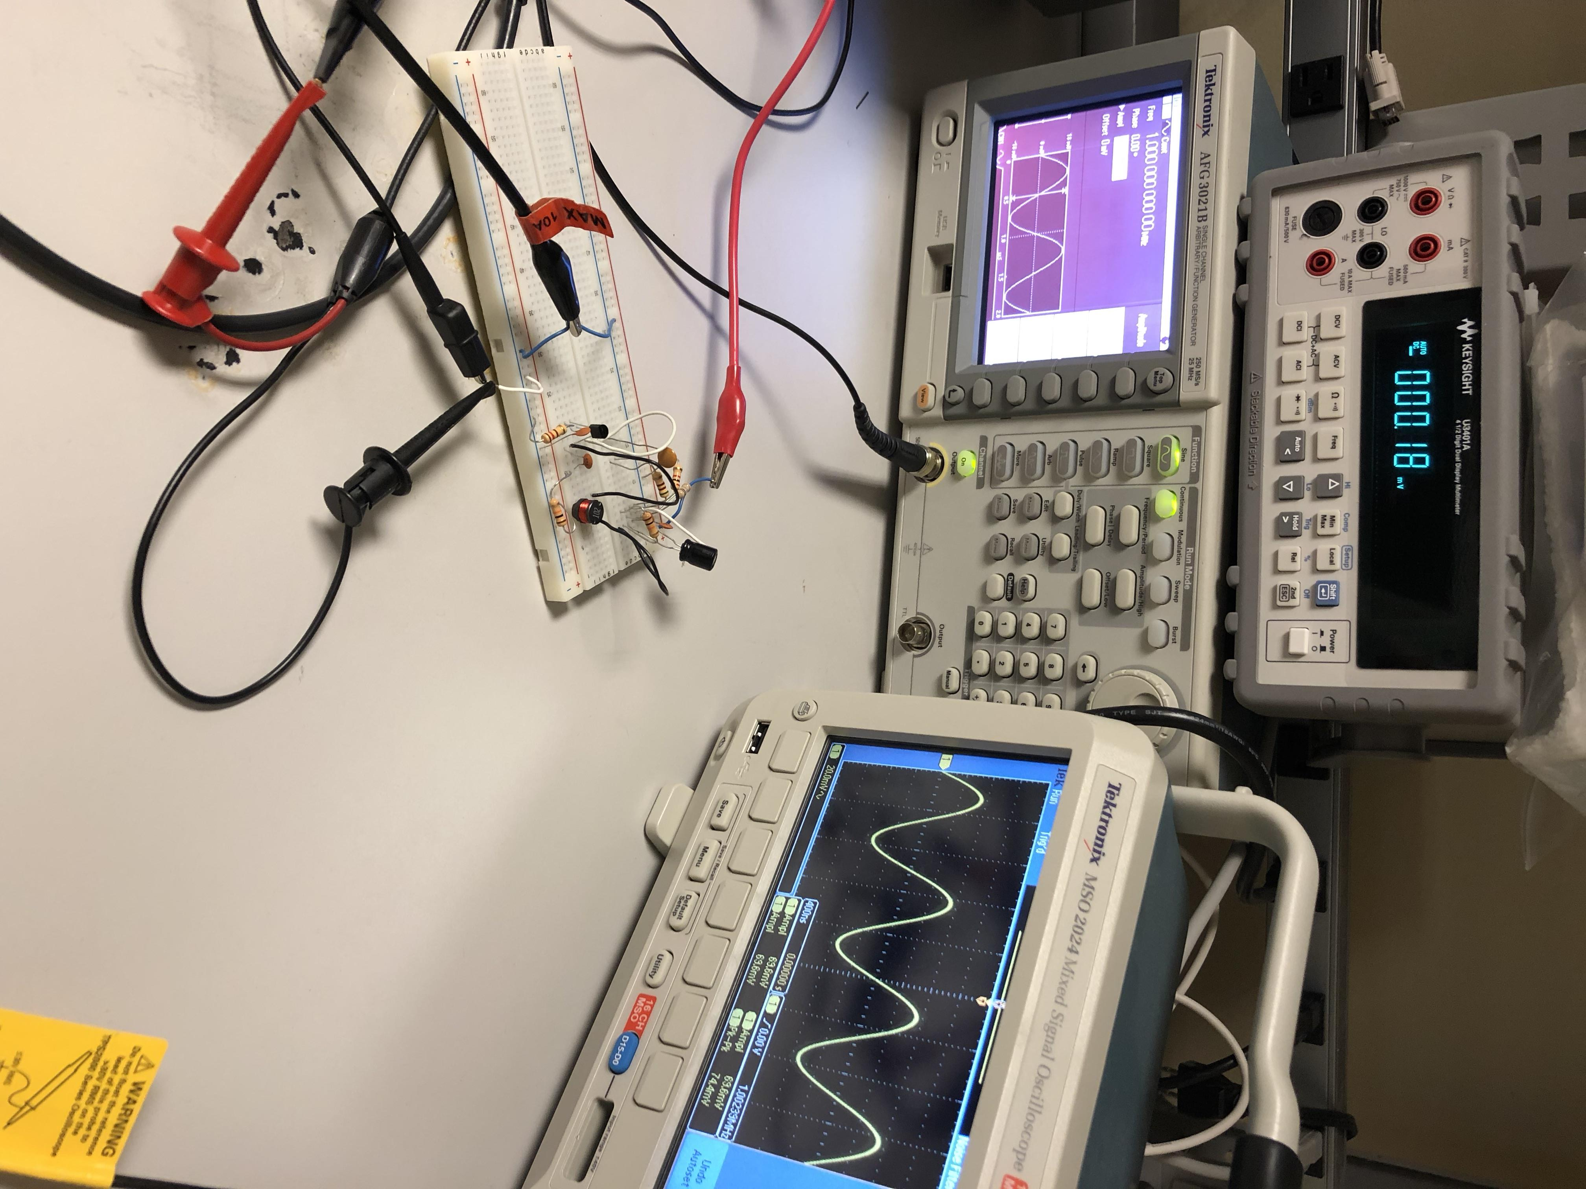
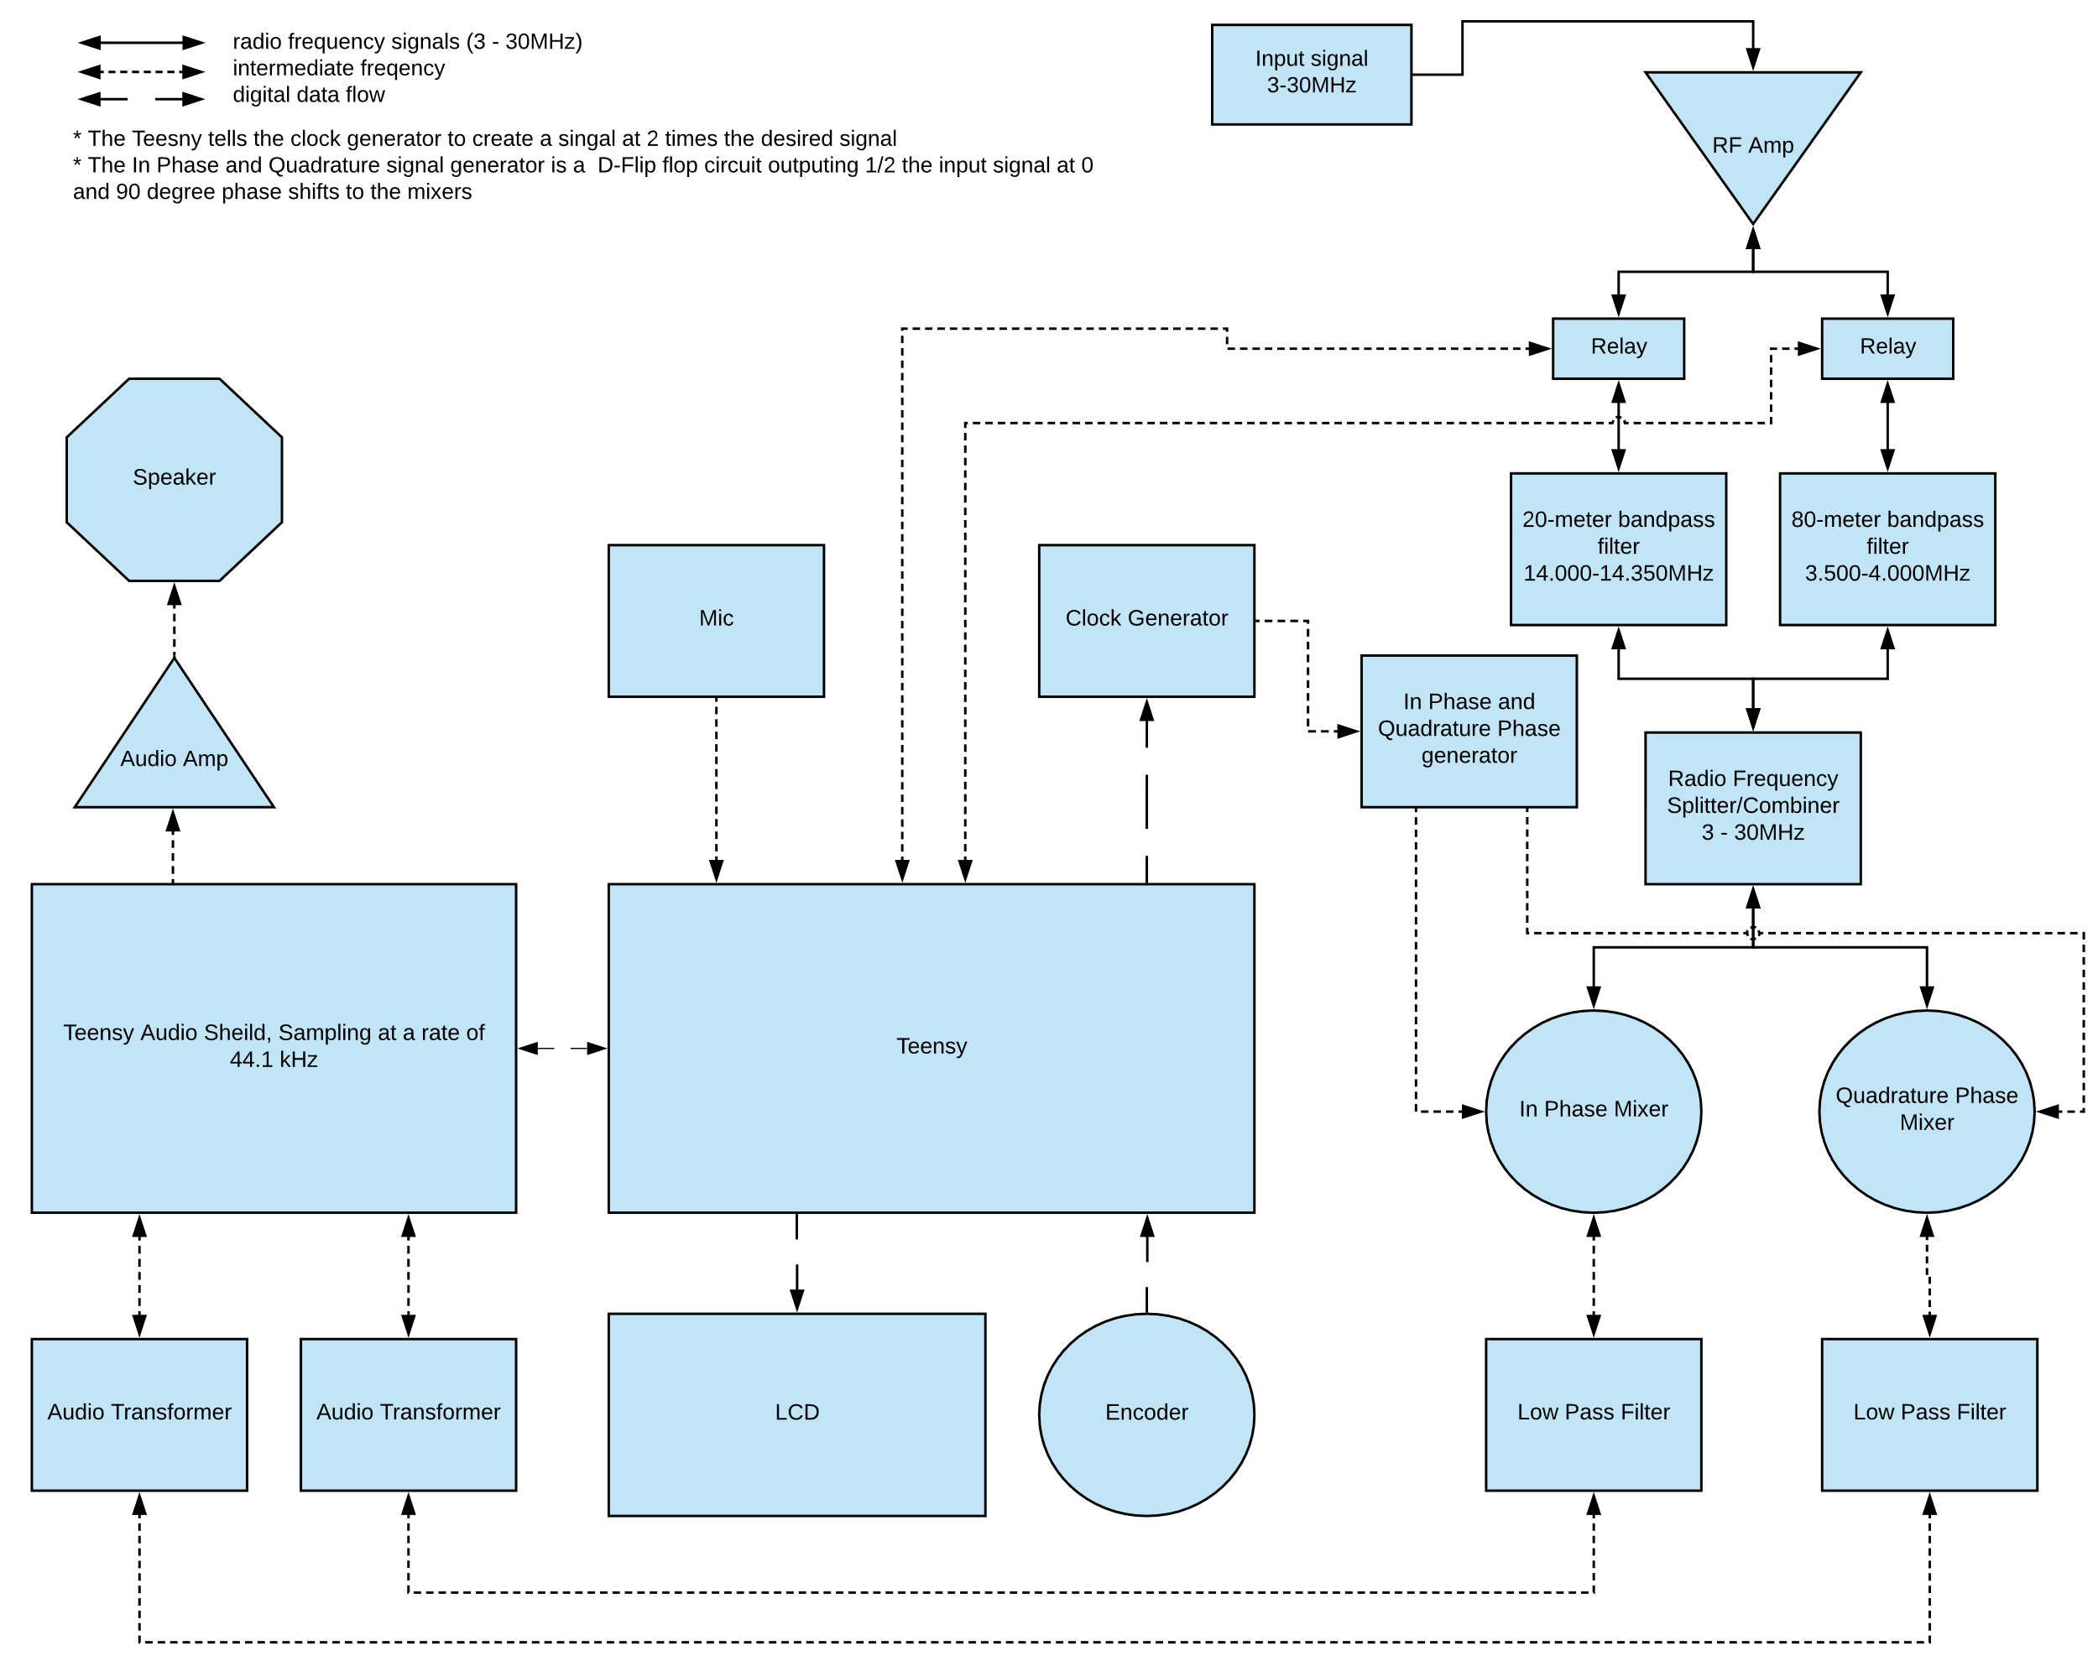
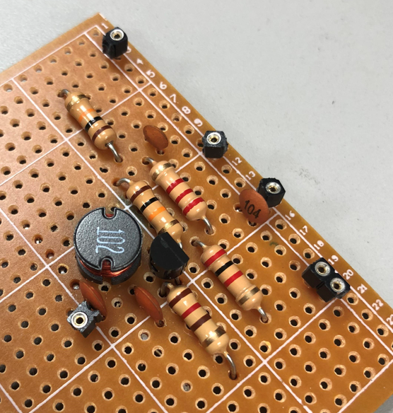
E1.12 – Software Defined Radio
Project Background
A Software Defined Radio is a HAM radio that is implementing primarily in software using, rather than traditionally in hardware. Some of the benefits to this design include:
Modified more easily, only requires change in software.
More expandable and flexible. RF Frontend can be changed with minimal change to software.
Less expensive to buy and create yourself
We have been sponsored to create a Software Defined Radio, based on a pre-existing design created by a radio enthusiast who posted the design online, named Charlie Morris.
We are basing our project on his design, with modifications to include some sponsor requirements, our own personal designs, as well as some improvements.
Project Manager
James Bell
Engineer
Samuel Hussey
Engineer
Zachary Schneiderman
Project Scope Description
In this project the team will build and test a high frequency software defined radio. With the following features:
The radio will be capable of receiving and transmitting on the North American 20-meter and 80-meter amateur radio bands.
It will perform transmissions in real-time.
It will show the frequency currently tuned to on an LCD.
It will have a frequency tuning knob.
Its estimated unit cost should be less than $300.
The signal received will be as understandable and clear as possible within the limits of our components.
The device will have a volume control for the speaker.
The device will have the option to select amateur license class.
Optional: Higher power amplifier for transmission.
Optional: Have the ability to run on an alternate power source such as a battery.
Optional: Be able to run with a Teensy or a Raspberry Pi.
Optional: Should have a headphone jack.
Approach
Next Semester
Significant research has had to be done in understanding radio receiving and transmitting. Including modulation, in depth amplifiers and filtering.
Fully tested and implemented RF Amplifier.
Low Pass Filters have been tested and implemented.
Quadrature and Clock Generator has been implemented.
Existing software has begun to be modified for our design.
Expand software for our user interfaces.
Need to finish receive implementation.
Need to begin transmit implementation.
Implement higher power amplifier, ideally 5W for long range.
Begin on stretch goals, time permitting.
Challenges & Boundary Conditions
Boundary | Constraint
The device should operate around the US specification of 120V AC 60Hz | The input power must be minimum 100V AC 50Hz, and cannot exceed 240V AC 60Hz
The RF Amplifiers Gain will be 15-20 at 3.5MHz and 12-15 at 14.5MHz | The RF Amplifiers Gain cannot exceed 60 over the 3.5-14.5MHz band
The NE612 will receive RF frequencies of 3.5-14.5MHz | The NE612 can receive 0-500MHz
The Teensy will receive 5V from a linear voltage regulator | The Teensy can receive 2.7-5.5V for Vcc
The radio will only operate on frequencies from 3.5-4.0MHz and 14.00-14.35MHz | The radio can tune to any frequency on the HF band, 3Mhz to 30Mhz
The Teensy will amplify the microphone signals from 0-20dB | The Teensy can amplify the microphone signals by 0-63dB
The lineout gain of the Teensy will be 13-20dB | The lineout gain of the Teensy can be 13-31dB
The typical transmit power will be between 18-25mW | The maximum transmit power cannot exceed 31mW
The radio will transmit signals from the microphone to the antenna in under 100ms | The radio cannot exceed a 500ms delay as it would make radio conversation difficult
Quadrature Generator Output with Sample Square Wave
Our simulations are not matching our actual devices
The amplifier simulation is not matching the actual build
An additional power amplifier will be necessary
The original design will not be able to transmit long distances
Some of the challenges we have faced so far have included:
Simulations not matching up with physical circuits, was particularly a problem with our RF Amplifier.
Extra parts needed to be ordered because the wrong form factor mixers were ordered, and a toroid core was broken in shipping.
None of the group members have experience with RF design, so extensive research and consulting has been necessary.
RF Amplifier Gain and Attenuation Testing
Acknowledgements
Project Manager: James Bell
D2 Advisor: Thomas Cowden
Course Advisor: Dr. Semih Aslan
Faculty Advisor: Dr. William Stapleton
Special Thanks to: Dr. Rich Compeau
Charles Morris
RF Amplifier Post Test with Access Points

